Slide 1

OotaOS
The AI-native operating system for restaurants.
One platform replacing the POS, QR ordering, kitchen display, reservations, CRM and marketing stack — built India-first, priced for the phone-first majority.
~624 API endpoints
4,700+ tests · zero skipped
US$17.39/mo infra — measured
98/100 pilot-ready
Seed Round · US$800K for 10% · US$8.0M post-money
OOTAOS PLATFORM SERVICES PRIVATE LIMITED · CIN U62011KA2026PTC223286 · Bengaluru, Karnataka · July 2026 · Confidential — verified against production release 76f67d0
Notes:
Open with the one-liner: OotaOS is the AI-native operating system for restaurants. The four chips are the whole thesis — the product is already built, tested, and runs on seventeen dollars a month. This round buys distribution, not development.

Slide 2
THE PROBLEM
Running one restaurant means running six systems.
POS
QR ordering
“Five aggregator tablets, one confused kitchen.”
Every channel is a separate screen; orders get missed between table and kitchen.
Reservations
Kitchen display
“Aggregator commissions eat my margin.”
CRM / loyalty
Marketing
20–30% per order, with no owned direct channel to shift demand to.
Six vendors. Six bills. Zero shared data.
“Switching POS means losing my data.”
And the tools that do exist are email-gated SaaS — while 85%+ of Indian eateries run on a phone number, not an inbox.
Menu, history and loyalty are hostage to the incumbent — the #1 switching blocker.
“I can’t read demand — I over- or under-prep.”
No forecasting, so waste and stock-outs are guesswork.
Pains verbatim from operator conversations · fragmentation tax paid monthly by the independents who make up most of the market
OotaOS · Seed 2026 · Confidential
2
Notes:
Anchor the problem in the operator's own words. The structural point: the market majority in India is phone-first, so the incumbent email-gated SaaS motion literally cannot reach them. That gap is both the problem and our distribution wedge.

Slide 3









THE SOLUTION
One platform. Scan to serve.
Guest scans QR
Kitchen sees it
Guest pays
Loyalty accrues
orders in any of 15 languages
→
realtime KDS in ~1 second
→
UPI, card — Razorpay or Stripe
→
bank-grade wallet, automatic
Scan-to-Serve Operations
Revenue & Growth Intelligence
Global Billing & Compliance
QR dine-in, ~1s KDS, table sessions, waitlist, Order-While-You-Wait
AI menu scan, smart upsell, 11 deterministic engines, ROI ledger, loyalty
Dual-gateway, 10 currencies, 12-country tax engine (activation-gated)
Zero-Friction Migration
OotaOS Lite
Platform Command & Trust
13+ POS fingerprints, dry-run first, readiness score, camera menu import
Zero-commission street-vendor tier; on-device UPI SMS confirmation
Master admin, dual-approval God Mode, tamper-evident audit chain
No new hardware · no card reader required · 14-day free trial · ~8-minute self-serve onboarding target
OotaOS · Seed 2026 · Confidential
3
Notes:
Walk the flow left to right — that four-step strip is the live demo in miniature. Then the six pillars: everything a restaurant currently pays six vendors for, in one coherent system with one data spine. Close on: no hardware, fourteen-day trial, eight-minute onboarding target.

Slide 4
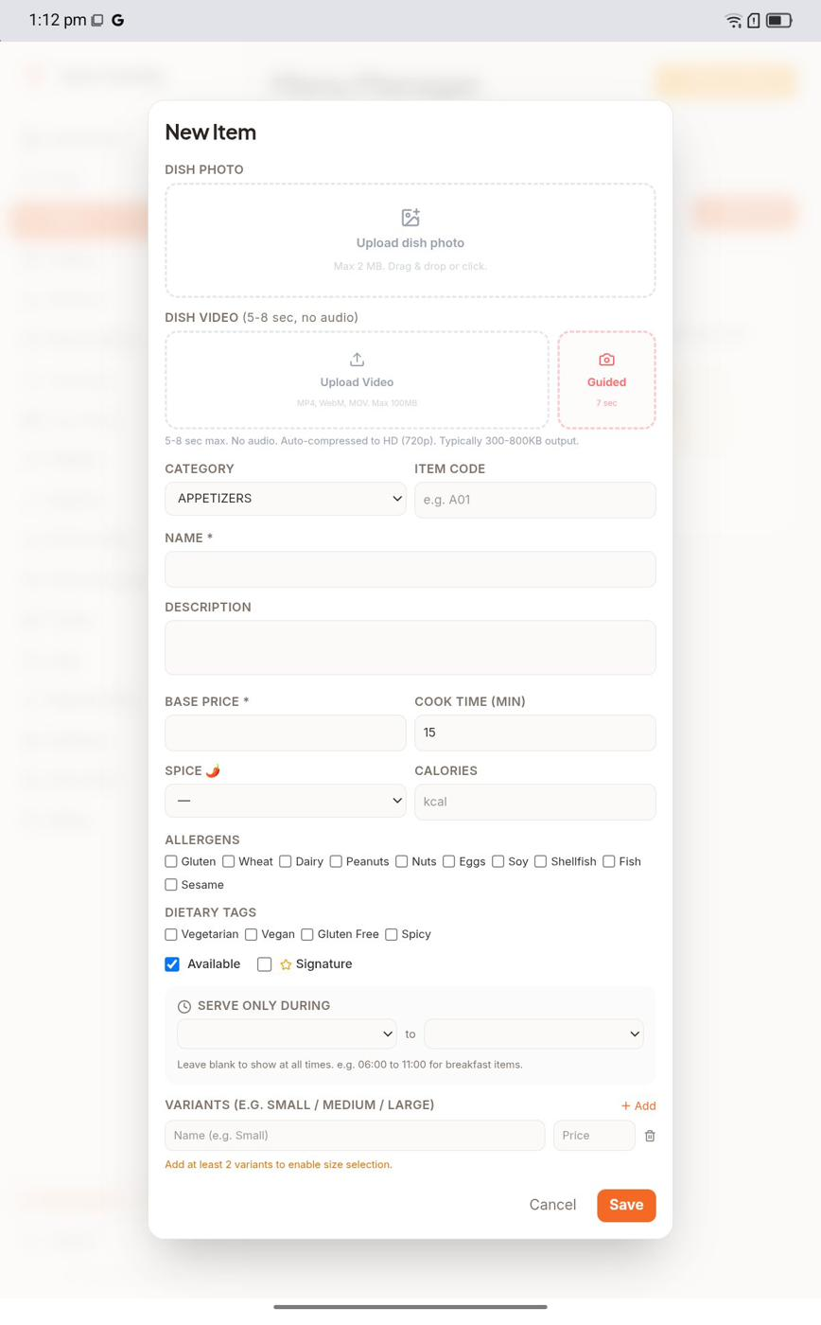
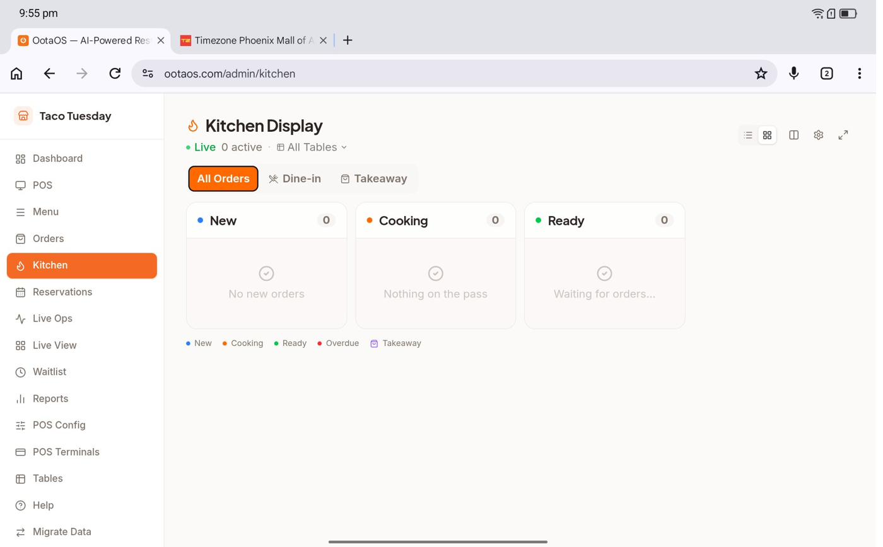
PRODUCT
Live in production — not a prototype.
Diner menu — guest phone
Realtime Kitchen Display — order lands ~1 second after the guest taps
Running on Railway · production release 76f67d0 · first design partner (SAPASA Cafe) in onboarding
OotaOS · Seed 2026 · Confidential
4
Notes:
Real screens from the production build. The story is one second: guest taps on their phone, the ticket is on the kitchen screen. If realtime ever degrades it silently falls back to a five-second poll — no order is ever lost.

Slide 5
DEPTH OF BUILD
Built and tested — before raising a rupee.
~624
~249
82
29
27
API endpoints
database tables
SPA routes
AI capabilities
background jobs
103 route modules
58 schema modules · 101 migrations
73 pages · mobile-responsive
verified in production code
Postgres-queued, idempotent
4,700+
15
10
13+
98/100
automated tests
menu languages
currencies
POS fingerprints
pilot-ready
544 files · zero skipped
cached translation
12-country tax engine, gated
AI migration engine
26-scenario gate
Correctness is engineered, not promised
DB-enforced money integrity (subtotal + tax + service + tip = total as a database constraint) · immutable tax snapshots · CAS-guarded order state machine · strict CSRF (boot-fatal) · AES-256-GCM encrypted gateway keys · tamper-evident admin audit chain — all live on both environments.
OotaOS · Seed 2026 · Confidential
5
Notes:
This is the diligence slide. Every number is code-verified against release 76f67d0 — nothing here is a projection. The bottom band matters most to technical diligence: money integrity is a database constraint, so a correctness failure cannot silently become a reconciliation cost.

Slide 6




WHY NOW
Five shifts converge on this exact product.
QR + UPI behaviour is universal
WhatsApp is the business channel
Scanning to pay is muscle memory across urban India — scanning to order is the natural next step, no hardware needed.
~500M Indian users; ~85% open rates vs ~20% for email — phone-first outreach reaches operators email-gated SaaS never will.
The AI cost curve finally works
Aggregator commission fatigue
Deterministic engines plus cost-efficient model tiers make per-restaurant AI viable at Indian price points — for the first time.
20–30% commissions have operators actively seeking an owned direct channel; hikes are a recurring buying trigger.
The compliance wave
The window
DPDP in India, subscription law in Australia, GST churn — compliance-grade platforms win the switch decision.
Incumbents are architected for email, cards and bolt-on AI. Rebuilding for phone-first, UPI-native, deterministic-AI economics is a rewrite — not a feature.
OotaOS · Seed 2026 · Confidential
6
Notes:
Timing, not just opportunity. Each shift is independently verifiable; together they explain why this product, built this way, wins now. The window card is the punchline — incumbents can't respond without a rewrite.

Slide 7
MARKET
A fast-compounding software market — sized honestly.
$7.5B → $14.7B
$254M → $848M
~$66–80B
Global restaurant-management software
India restaurant-management software
India food-services market (FY24)
2026 → 2030–31 · 17%+ CAGR · Grand View / Mordor
2024 → 2030 · 22.8% CAGR · Grand View
NRAI / Redseer · organized segment ~$30B
~$3.2B
~$210M
Bottom-up, not hand-waved
The M18 base plan (3,500 restaurants, $6.3M ARR) is ~3% of India SAM alone — the model does not require heroic share.
APAC serviceable market
India SAM (2026)
restaurant software, addressable via the 10-currency build
our beachhead — the software spend we sell into first
One source per figure · scope labelled (software spend ≠ food-service GMV) · Lite additionally opens the micro-eatery segment incumbents structurally cannot serve.
OotaOS · Seed 2026 · Confidential
7
Notes:
Every figure is single-sourced and scope-labelled — software spend, not food GMV. The credibility move is the orange card: the whole eighteen-month plan needs roughly three percent of India's serviceable software market. Lite then opens a segment nobody else prices for.

Slide 8
BUSINESS MODEL
SaaS tiers plus a micro-priced street-vendor rail.
Starter
Growth
Pro
Lite
₹499 cap + ₹2/order
₹2,499/mo
₹4,999/mo
₹0.15/order
$29/mo (US)
$79/mo (US)
$129/mo (US)
$0.05/order intl*
QR + KDS day one — the on-ramp
“The tier that makes you money” — upsell, loyalty, CRM, delivery ingestion, reservations
Campaigns + tax filing; deepening deliberately
Zero commission, no monthly fee — street vendors & micro-eateries
$28 → $150
blended ARPU ramp, M3 → M18 (design target)
10 currencies
annual plans ≈ 21% discount · 14-day free trial
4.89% / 5.89% + $0.30
managed-payments take (IN / intl) — margin-positive by construction
70–75%
gross-margin design target — absorbs processing + support
*International Lite billing priced and designed; activates after India. Metered add-on levers (AI credits, migration Smart Assist) already exist in code.
OotaOS · Seed 2026 · Confidential
8
Notes:
Growth is the natural upgrade — every money-making feature sits behind that one gate. Lite is the segment weapon: per-order micro-pricing with zero commission, which a card-terminal incumbent cannot copy without breaking its own model. ARPU ramp and margins are labelled design targets until telemetry lands.

Slide 9



GO-TO-MARKET
A 10× CAC asymmetry, engineered end-to-end.
$140
Proprietary database
$1,400–$2,000
38,770 self-collected restaurant records across 7 metros → 300K by M6 (Overture Maps + OSM + FSSAI pipeline).
industry CAC — reps, trade shows, resellers
OotaOS design-target CAC — 10× lower
WhatsApp-first, opt-in
~85% WhatsApp reachability on covered phones; BSP-compliant warm outreach. Voice + QR field drops (<$0.06/restaurant) behind it.
Funnel design targets (telemetry replaces from M1):
Product-true lead magnets
3–5%
outreach→demo
60%
demo→trial
25%
trial→paid
30%
90-day upgrade
Free AI menu digitisation and the Migration Readiness Report — the product qualifies its own leads.
Self-serve on-ramp
Illustrative: 300K database × 4% demo × 60% trial × 25% paid ≈ 1,800 paid restaurants from the first full outreach wave (all design targets). Monthly churn targets: 3% India / 2% international.
AI menu scan → QR bootstrap → first order: ~8-minute onboarding target — outreach converts without a field sales force.
Phone-first identity meets the market where it actually lives.
OotaOS · Seed 2026 · Confidential
9
Notes:
The asymmetry has two halves: distribution nobody else has (a self-collected phone-first database reached over WhatsApp) and a product that converts without a sales force. Be explicit that funnel numbers are design targets — measurement is instrumented from month one, and every target is replaced by telemetry as it lands.

Slide 10

DEFENSIBILITY
Six moats — each already shipped.
Switching-cost wedge
Structural AI economics
Phone-first database
The AI migration engine turns “we already use X” into a five-minute import — and deepens data lock-in with every switch.
60–80% of AI workload runs on in-house deterministic engines at near-zero token cost — margins LLM-per-click competitors cannot sustain.
No competitor has self-collected restaurant phone + location data at this scale; every enrichment pass compounds it.
Loyalty network spine
Compliance & correctness lead
Depth as a barrier
A shared, currency-scoped diner wallet grows more valuable to every diner and restaurant as the network grows.
DB-enforced money integrity, a 12-country tax engine, AU subscription law a year early — expensive to catch up to.
~624 endpoints and 4,700+ tests are themselves a moat: a large, coherent, validated surface area.
OotaOS · Seed 2026 · Confidential
10
Notes:
None of these is a roadmap item — each is verifiable in the production codebase today. If pressed on which matters most: the AI cost structure. Competitors bolting an LLM onto every screen pay per interaction, forever; our intelligence layer is deterministic-first by design.

Slide 11

COST ARCHITECTURE
The entire platform runs on $17.39 a month.
US$17.39
Deterministic intelligence —
11 in-house engines serve 60–80% of AI workload with no external API call.
Guardrailed external AI —
Cost-efficient model tiers; trimmed, bounded, metered per-restaurant budgets — every call logged.
per month — measured from the live July 2026 Railway bill. The full production platform and database, across both production and development environments.
Postgres-backed job queue —
27 jobs on SKIP LOCKED — no Redis, no RabbitMQ to provision, secure and pay for.
Memory is ~96% of the bill · under 0.1 vCPU average · under 3 GB egress/month
Zero-egress media —
Browser → Cloudinary CDN direct; the server only signs uploads.
“At most seed rounds, capital buys the build. Here the build exists — and its entire monthly cloud bill costs less than a takeaway dinner.”
Cached translation —
Per-string SHA-256 cache — each menu string translated once, ever.
Nothing pays idle rent —
Boot-time env-guard across ~22 capability groups; SMS parked at $0 until registration completes.
OotaOS · Seed 2026 · Confidential
11
Notes:
This is the slide investors remember. Seventeen dollars and thirty-nine cents, measured — not projected — and it's the direct result of six deliberate architecture decisions visible in the production code. The takeaway line: this round buys distribution, because the build already exists and costs nothing to keep alive.

Slide 12
UNIT ECONOMICS
Infrastructure scales sub-linearly with revenue.
Milestone | Restaurants | MRR (target) | Est. infra / mo | Infra as % of MRR
Today (pre-GA) | pilot | — | $17.39 (measured) | —
M6 | 500 | $25K | $450 – $1,000 | ~2–4%
M12 | 1,500 | $150K | $1,200 – $3,000 | ~1–2%
M18 (base) | 3,500 | $525K | $3,000 – $8,000 | ~0.6–1.5%
70–75%
gross-margin design target
$140
blended CAC vs $1,400–$2,000 industry
3–4 mo
payback vs 20–23 months industry
Anchored to measured Railway unit rates + published vendor tiers. As MRR grows ~20× from M6 to M18, infrastructure grows ~8× — and its share of revenue falls.
12–18×
LTV / CAC design target
Every figure here is a design target or published-pricing estimate until production telemetry exists — and is labelled as such. Measurement is instrumented from M1; telemetry replaces targets as it lands.
~M8
cash-flow positive — Year-1 OpEx ~$521K vs $800K opening cash
OotaOS · Seed 2026 · Confidential
12
Notes:
The structural point: a single coherent monolith on managed services means infra share of revenue falls toward under one and a half percent at M18 — which is what protects the seventy to seventy-five percent gross-margin target. The honesty card at the bottom is deliberate: we label every target, and telemetry replaces them from month one.

Slide 13



TRACTION, STATED HONESTLY
Pre-GA and pre-revenue — by design.
Incorporated 1 July 2026
Platform built pre-funding
OOTAOS PLATFORM SERVICES PVT LTD — clean standalone entity, CIN-registered, Companies Act 2013.
The founder chose to finish a genuinely complete platform before selling it — the diligence proof is the product itself.
First design partner onboarding
98/100 pilot-ready
SAPASA Cafe is in onboarding (not yet live). Zero paying customers, zero LOIs — we will not inflate this.
26-scenario manual gate on release 76f67d0; 4,700+ automated tests, zero skipped.
Launch discipline: marketing never outruns the product
Capabilities not yet live are tracked explicitly and held out of GTM: international Lite billing (priced, activation pending) · Lite Android APK (built; signing/hosting pending) · v4 tax engine (built and tested, activated market-by-market) · reservations online payment (excluded until the gateway session ships). Benefit claims are quantified from pilot telemetry before use — never before.
OotaOS · Seed 2026 · Confidential
13
Notes:
Lead with the discipline, not an apology. Zero customers is a choice with a reason: the founder finished the platform first, so what you diligence is code, not promises. The launch-discipline band is the credibility multiplier — we track exactly which claims are gated and why.

Slide 14
COMPETITION
Billing-first POS vs. a whole operating system.
 | Petpooja / POSist | UrbanPiper | Square / Toast / Clover | OotaOS
Scope | Billing-first POS | Aggregator middleware | Card-first POS (intl) | Full restaurant OS — one data spine
Reach | Email-gated sales motion | Enterprise/chain-led | Card-economy assumptions | Phone-first: WhatsApp, UPI, vernacular
AI economics | Bolt-on, per-call LLM cost | — | Add-on modules | Deterministic-first: 60–80% at ~zero token cost
Switching | Data lock-in is the moat | — | Contract + hardware lock-in | AI migration engine removes the blocker
Micro-eateries | Not served | Not served | Not served | Lite: ₹0.15/order, zero commission
Stated plainly: incumbents are funded and entrenched. Our wedge is the QR-need dine-in segment, the phone-first majority their motion cannot reach, and a migration engine that turns their lock-in into our on-ramp.
OotaOS · Seed 2026 · Confidential
14
Notes:
Respect the incumbents — then reframe. They are billing-first point solutions; OotaOS is the operating system. The last row is the quiet killer: nobody prices for the street-vendor segment, and Lite's on-device UPI confirmation is a mechanism a card-terminal company structurally cannot copy.

Slide 15
THE PLAN
Eighteen months, five milestones, default-alive.
M1
M6
M12
GA launch
500 restaurants
1,500 restaurants
telemetry instrumented from day one; design-partner wave
$25K MRR · $300K ARR · database at 300K records
$150K MRR · $1.8M ARR · AU/international opens
M3
M8
M18
ARPU ramp begins
Cash-flow positive
3,500 restaurants
blended ARPU $28; outreach engine at full cadence
Year-1 OpEx ~$521K vs $800K opening cash
$525K MRR · $6.3M ARR base
M18 range: $3.82M ARR conservative · $6.3M base · $9.0M aggressive. All milestones are design targets; measured CAC by channel, activation and churn are reported weekly from the first outreach wave.
OotaOS · Seed 2026 · Confidential
15
Notes:
Two milestones matter more than the rest: M8 cash-flow positive — this company is default-alive on one round — and M6, where the database hits three hundred thousand records and the outreach engine is fully proven or fully corrected. Give the range honestly: three-point-eight conservative, nine aggressive.

Slide 16
RISKS, STATED PLAINLY
What could kill this — and how the round retires it.
Risk | Honest statement | How the round retires it
Adoption (pre-revenue, pre-GA) | Zero paying customers today. Proof is product depth, not traction. | 40% of the round funds sales & onboarding; design-partner wave first; telemetry from M1 replaces every target with a measurement.
Key-person engineering | Deep founder dependency on the codebase. | 25% funds engineering hires; the 4,700-test estate and documented build waves reduce (not eliminate) bus-factor risk.
Lite funnel unshipped | The Lite APK is built but signing/hosting is pending — that acquisition funnel is closed today. | A scoped, funded release step; the vendor download funnel opens on release.
Funded incumbents | Petpooja/POSist are entrenched with distribution. | We do not fight their motion — we bypass it (phone-first) and dissolve their lock-in (migration engine).
Execution outrunning truth | The classic startup failure: claims before capability. | Launch discipline is codified — gated capabilities are tracked and held out of GTM until live.
We present risk honestly because the product depth lets us afford to.
OotaOS · Seed 2026 · Confidential
16
Notes:
Do not rush this slide — it is the trust anchor of the whole deck. Each risk is real, each mitigation is specific and funded. The closing line is the brand: we can afford honesty because the build is already there to be diligenced.

Slide 17
TEAM
The build is the credential.
Krish Chimakurthy
The team today
Founder & CEO
Founder & CEO · 1 full-time engineer · 2 interns · 3 technical advisors
Nearly two decades across IT delivery, software testing, project management and AI engineering — big-consulting rigor at startup speed.
Shipped the entire OotaOS platform pre-funding: ~624 endpoints, ~249 tables, 4,700+ tests — zero skipped. The testing-first DNA is visible in the code.
Dual Australian–Indian citizen (OCI) — native footing for the India-first, Australia-next expansion sequence.
Funded by this round
AI Marketing & Sales Head (M1) — owns the outreach engine end-to-end · Customer Success Lead (M3) — owns onboarding and design partners · engineering hires to retire key-person risk.
Why this founder, this problem: a career spent making software provably correct — applied to an industry that runs on unreconciled spreadsheets and six disconnected tools.
OotaOS · Seed 2026 · Confidential
17
Notes:
The founder-market fit is the testing background: two decades of making software provably correct, now pointed at an industry with none. Acknowledge the key-person risk directly — it's on the risk slide — and note that engineering hires are a named use of proceeds.

Slide 18
THE ASK
US$800K for 10% — to buy distribution, not development.
US$800,000
Use of funds
10% equity · US$8.0M post-money (US$7.2M pre · ~US$648/share)
Fresh equity allotment under §62(1)(c), Companies Act 2013
9% ESOP pool created pre-money — investor is not diluted by it
Clean, single-entity cap table — no notes, no SAFEs, no debt
What the money does not buy: servers ($17.39/mo, measured) or a rewrite (98/100 pilot-ready). It buys GA execution and 3,500 restaurants by M18 — with cash-flow positive targeted at ~M8.
OotaOS · Seed 2026 · Confidential
18
Notes:
Terms first, then structure: fresh primary equity, ESOP carved pre-money so the investor's ten percent is real, and a cap table with nothing exotic on it. Then hand the room the pie: forty percent of the round goes straight to sales and onboarding, because distribution is the only remaining job.

Slide 19
OotaOS
The build exists. The bill is $17.39. The round buys distribution.
1
The build already exists
2
The cost curve is engineered, not hoped for
~624 endpoints · ~249 tables · 4,700+ tests · 29 AI capabilities · 98/100 pilot-ready — shipped pre-funding.
Deterministic intelligence, guardrailed AI, Postgres-queue simplicity, zero-egress media — a measured $17.39/month.
3
The GTM asymmetry is proprietary
4
Infrastructure share of revenue falls as we grow
38,770 phone-first records → 300K, reached over WhatsApp — a $140 design-target CAC against a $1,400+ industry.
From low single digits at M6 toward ~0.6–1.5% at M18 — structurally protecting 70–75% gross margin.
ootaos.com · OOTAOS PLATFORM SERVICES PRIVATE LIMITED · CIN U62011KA2026PTC223286 · Bengaluru, Karnataka · Confidential — not for distribution
OotaOS · Seed 2026 · Confidential
19
Notes:
Close on the sentence at the top and stop talking. If there is time for one more line: every unit-economics figure in this deck is a labelled design target until telemetry exists — and telemetry starts at month one.

Slide 20
APPENDIX A
Cap table & round mechanics.
Holder | Post-round % | Notes
Founder | ~76.95% | Single founder; full IP assignment executed
Spouse (minority) | ~4.05% | Held via gift deed
ESOP pool | 9.00% | Created pre-money — does not dilute the incoming investor
Seed investor | 10.00% | Fresh equity allotment under §62(1)(c)
US$8.0M post-money · US$7.2M pre-money · ~US$648/share
Primary capital only — no secondaries, no convertible notes, no SAFEs, no debt
15-document Indian seed legal pack prepared: Term Sheet, SSA, SHA, ESOP Scheme, IP Assignment, board & filing set
Entity: OOTAOS PLATFORM SERVICES PRIVATE LIMITED · incorporated 1 July 2026 · Bengaluru, Karnataka
OotaOS · Seed 2026 · Confidential
20
Notes:
Everything a term-sheet lawyer asks on day one, on one slide: clean single entity, primary-only round, ESOP carved before the money, and the legal pack already drafted.

Slide 21


APPENDIX B
Security & trust architecture — live in production.
Strict CSRF, boot-fatal
AES-256-GCM gateway keys
The server refuses to start misconfigured; env-guard validates ~22 capability groups.
Per-restaurant payment secrets encrypted at rest; hand-rolled signed REST, no server SDK sprawl.
Tamper-evident audit chain
DB-enforced money integrity
Hash-chained admin audit log; dual-approval God Mode for destructive operations.
subtotal + tax + service + tip = total as a database constraint; immutable tax snapshots.
Webhook hygiene
PII-safe by default
Raw-body HMAC verification on every gateway webhook; dedup ledger; dead-letter triage.
Three-layer PII masking in support AI; Sentry on an 18-key allow-list — no default PII.
Compliance posture
Operational runbooks
DPDP (India) readiness track; AU subscription law shipped a year early; 12-country tax engine, activation-gated.
Incident response, backup/restore, secret rotation and disclosure policy documented; SOC 2 readiness matrix maintained.
OotaOS · Seed 2026 · Confidential
21
Notes:
For technical diligence: everything on this slide is verifiable in the production codebase and the runbook set. The theme is the same as the money slide — guarantees enforced in code and schema, not promised in a policy document.

Slide 22
APPENDIX C
Priced for 10 currencies — from day one.
Currency | Starter cap | Starter /order | Growth /mo | Growth /yr | Pro /mo | Pro /yr
INR ₹ | 499 | 2 | 2,499 | 23,699 | 4,999 | 47,399
USD $ | 29 | 0.19 | 79 | 749 | 129 | 1,219
AUD A$ | 39 | 0.29 | 99 | 939 | 169 | 1,599
CAD C$ | 39 | 0.25 | 99 | 939 | 169 | 1,599
GBP £ | 24 | 0.15 | 69 | 649 | 109 | 1,029
EUR € | 27 | 0.19 | 74 | 699 | 119 | 1,129
SGD S$ | 39 | 0.35 | 99 | 939 | 159 | 1,499
AED | 99 | 0.69 | 279 | 2,649 | 449 | 4,249
MYR RM | 14.90 | 0.15 | 119 | 1,129 | 249 | 2,359
IDR Rp | 49,000 | 500 | 399,000 | 3,799,000 | 799,000 | 7,599,000
OotaOS Lite: ₹0.15/order (India) · $0.05/order non-India (Rp40 IDR exception) — per-order only, no monthly fee. Annual plans ≈ 21% discount. Currency-scoped billing live via Razorpay (India) + Stripe (7 markets).
OotaOS · Seed 2026 · Confidential
22
Notes:
This table is the proof that the international story is configuration, not a rebuild: pricing, currency scoping and tax packs exist for every listed market, activation-gated by choice.

