Slide 1

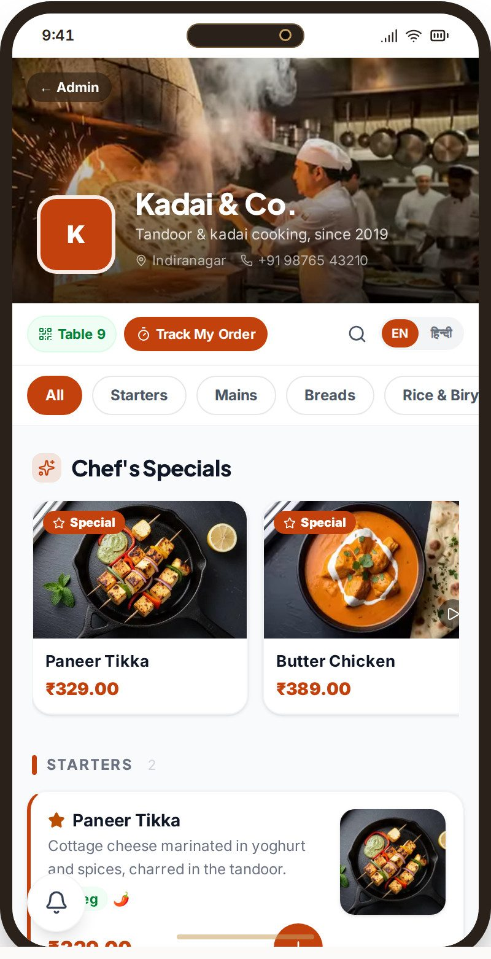
SEED ROUND · SEPTEMBER 2026 · BENGALURU, INDIA
The operating layer for restaurants.
One platform replacing the 8–12 disconnected tools a restaurant runs on — built pre-funding, production-deployed, live in ten markets. Raising US $800K to take it to its first paying markets.
30
10
14
0
admin modules live
market configurations
AI engines
mockups in this deck
Krish Chimakurthy · Founder & CEO · info@ootaos.com
OotaOS · Seed 2026 · Confidential · Live product: ootaos.com/product
1

Slide 2
THE PROBLEM
Restaurants run on a fragmentation tax, a commission tax and a compliance tax — and the smallest ones are locked out entirely.
1
2
3
4
FRAGMENTATION TAX
COMMISSION TAX
THE UNSERVED BOTTOM
COMPLIANCE TAX
A typical independent stitches together 5–10 subscriptions: QR menu, KDS, POS, CRM/loyalty, payments, reservations, aggregator tablets. None share data. The menu is entered three times; the owner reconciles by hand.
Delivery aggregators take 20–30% of order value and own the customer relationship. The restaurant becomes a fulfilment kitchen with no direct channel and no data.
India's street vendors and micro-eateries — millions of them — have no POS, no card reader and no monthly-fee budget. Existing tools assume a terminal, a subscription and a back office they do not have.
Tax rules, invoice numbering and data-protection regimes (GST, DPDP Act, GDPR, Australian UCT) differ by market. Getting it wrong is not a feature gap — it is legal exposure.
The result: 8–12 logins, 8–12 versions of the truth, and an owner who cannot answer "what happened tonight?" without a spreadsheet. Restaurants don't have a software problem. They have a systems problem.
OotaOS · Seed 2026 · Confidential · Live product: ootaos.com/product
2

Slide 3
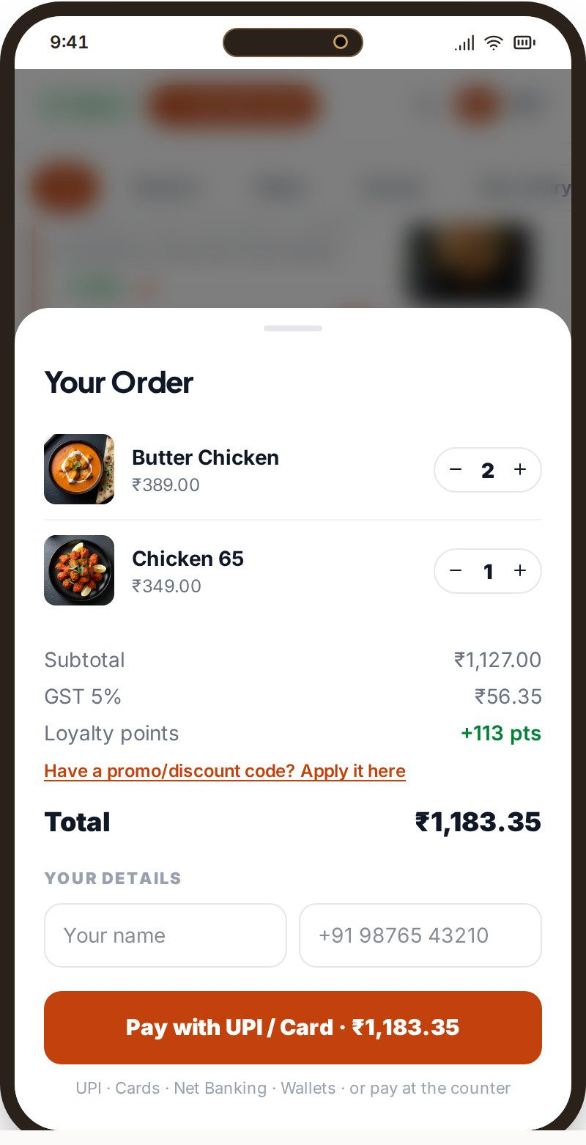
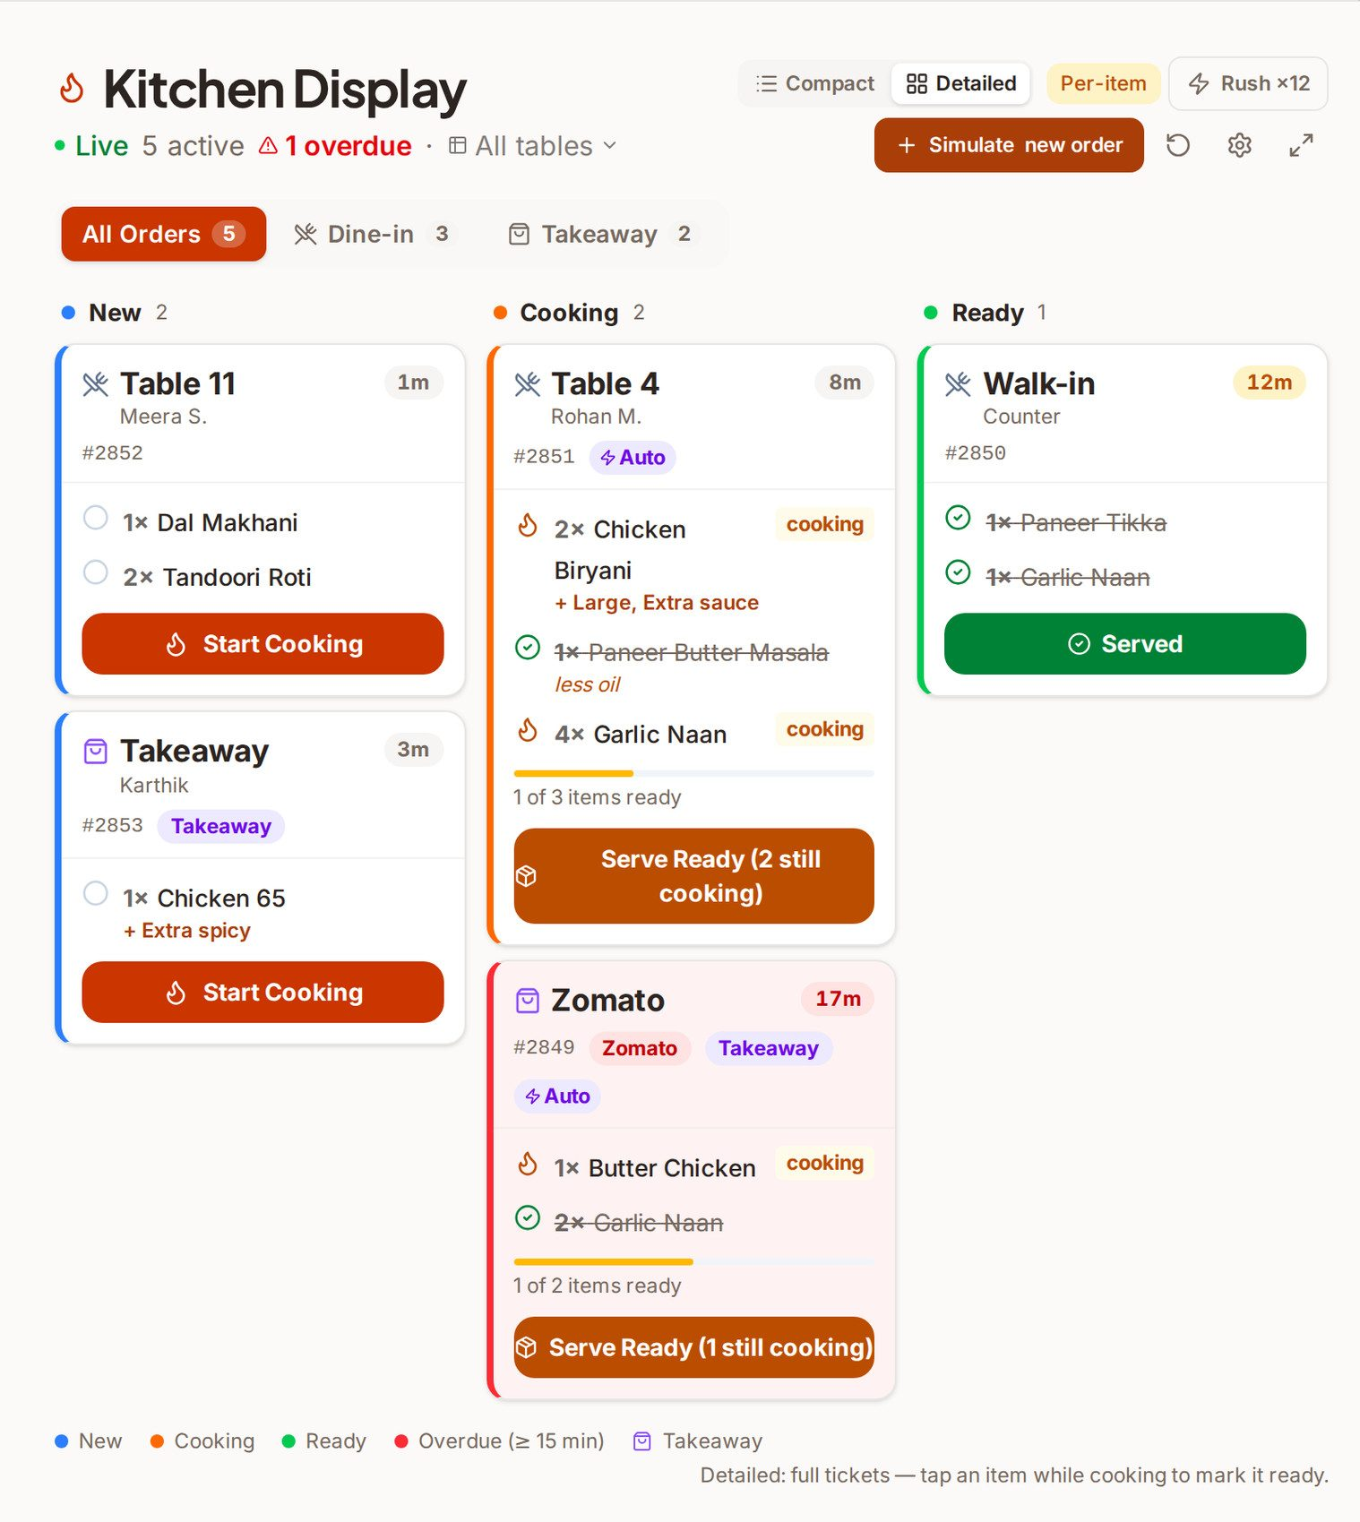
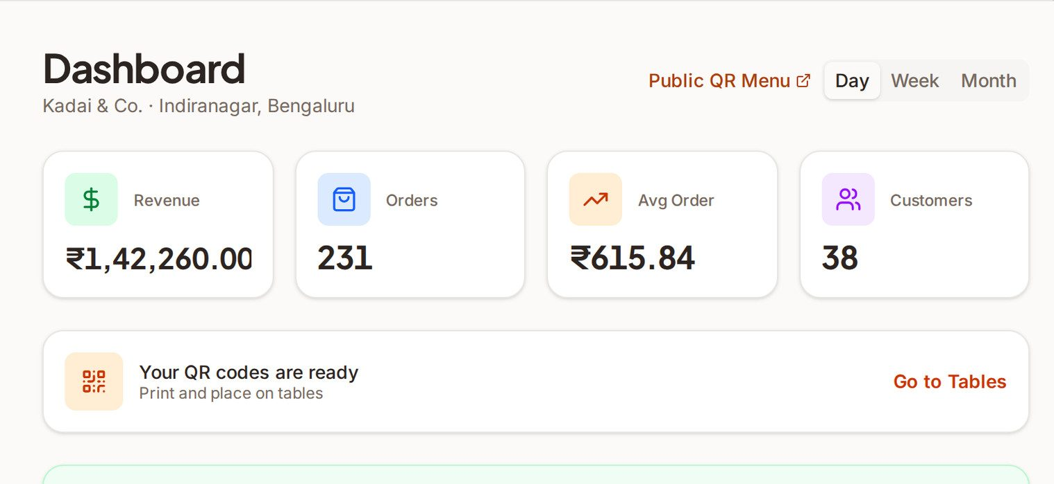

THE SOLUTION
OotaOS: one restaurant operating layer — customer, floor, kitchen, money, intelligence — on one data model.
Sign up, scan the paper menu, take QR orders the same afternoon. One menu entered once flows to the guest QR, POS, kitchen display, CRM, loyalty, payments, tax invoices and reports. Every screen below is a real capture of the live demo.
Owner: tonight's numbers from the same ledger
TRY THE LIVE PRODUCT
ootaos.com/product
Nothing here is a mockup — open it on your phone.
Guest: QR menu → cart → pay (GST 5%, UPI)
Kitchen: live board, per-item states, Zomato tickets
Under the surface: identity · visit · table · multi-device orders · kitchen state · payment state · tax · customer profile · loyalty · configuration · analytics · permissions · AI context — thirteen states managed for every visit.
OotaOS · Seed 2026 · Confidential · Live product: ootaos.com/product
3

Slide 4
WHY NOW
The behaviour change has already happened. The software has not caught up.
Guests already scan and pay at the table
Aggregator commission is a felt pain
QR ordering and UPI at the table are normal in India and accepted across our markets — no education cost for the guest side.
At 20–30% per order, "get orders direct" is a problem owners will pay to solve — and it needs a channel, a CRM and a kitchen that are one system.
Incumbent stacks are fragmented and un-localised
AI on owned operating data is now cheap and explainable
Global POS suites are priced and built for the West; India POS tools stop at the border. Neither models the visit, the guest and the money together.
Engines that read a restaurant's own ledger and propose actions with reasons can run at SMB price points — but only for a platform that owns the ledger.
The window: the first platform to own the full operating context in India and take it to the next nine markets sets the standard the rest have to follow.
OotaOS · Seed 2026 · Confidential · Live product: ootaos.com/product
4

Slide 5
MARKET
A US $7.5B software market growing 17%+ a year — with India, our first market, growing at 22.8%.
Layer | Size | Scope | Source
TAM | ~US $7.5B (2026) → ~$14.7B (2030–31) | Global restaurant-management software · 17%+ CAGR | Grand View Research (primary) / Mordor Intelligence
SAM | ~US $3.2B | APAC restaurant-management software | Internal sizing on Grand View / Mordor
INDIA SAM | ~US $210M (2026) | India RMS: $254M (2024) → $848M (2030) · 22.8% CAGR | Grand View Research
SOM | US $6.3M ARR | 3,500 restaurants by M18 (base case) | OotaOS financial model, base case
TAM · GLOBAL
SAM · APAC
INDIA SAM
SOM
$6.3M ARR
CONTEXT · THE UNDERLYING INDUSTRY
India food-services: ~US $66–80B (FY24; NRAI / Redseer) — organised segment ~$30B growing 13.2%
Software spend is a small, fast-growing slice of a very large industry; the long tail (street food, micro-eateries) is largely unserved by any software today — OotaOS Lite is priced for it (₹0.15 / order)
Scope discipline: software market ≠ food-service market; one source per figure. SOM is the plan, not a measured share.
OotaOS · Seed 2026 · Confidential · Live product: ootaos.com/product
5

Slide 6
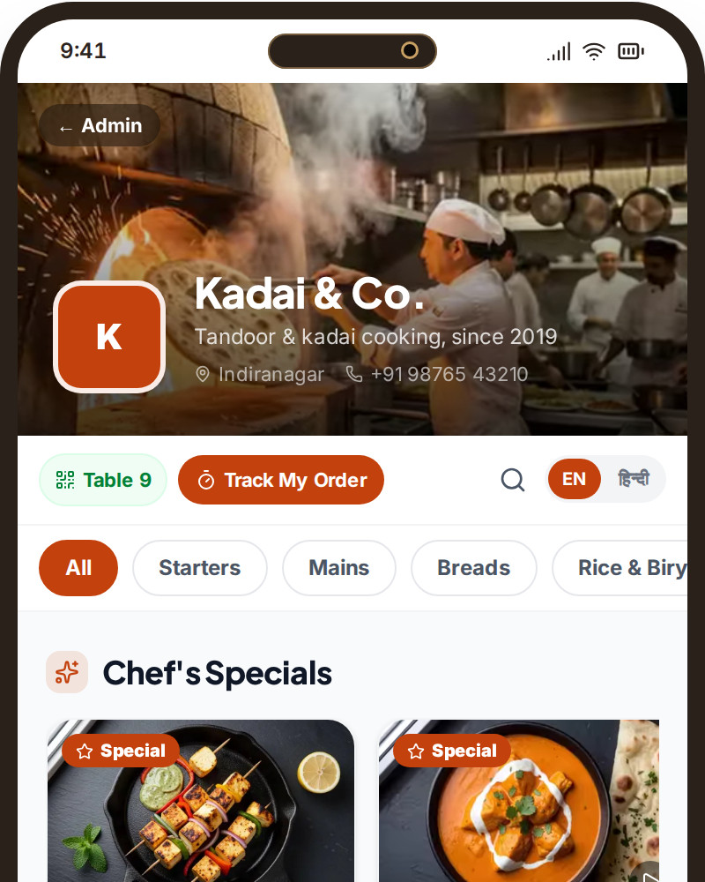
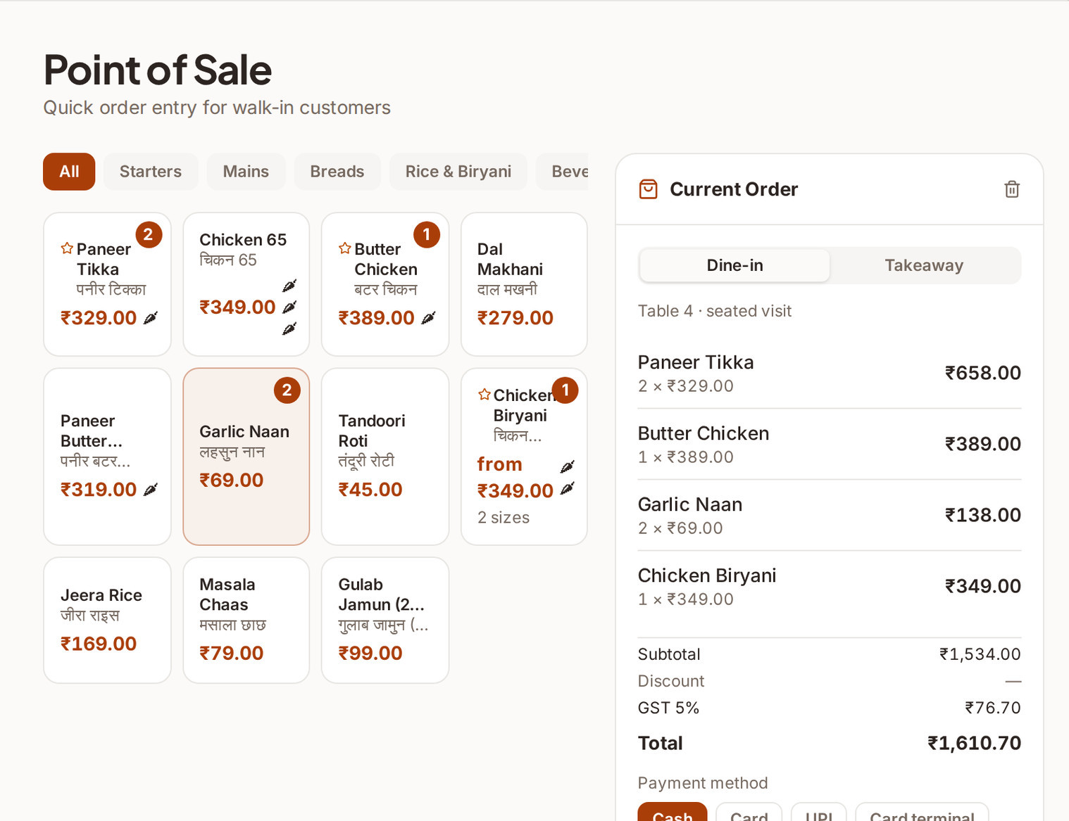
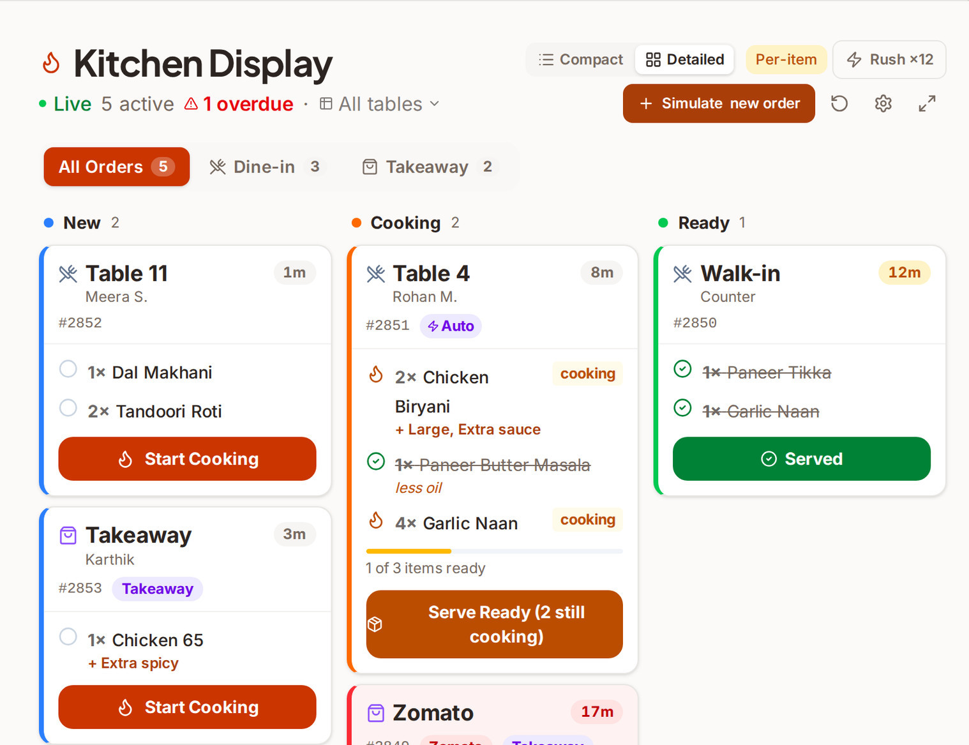
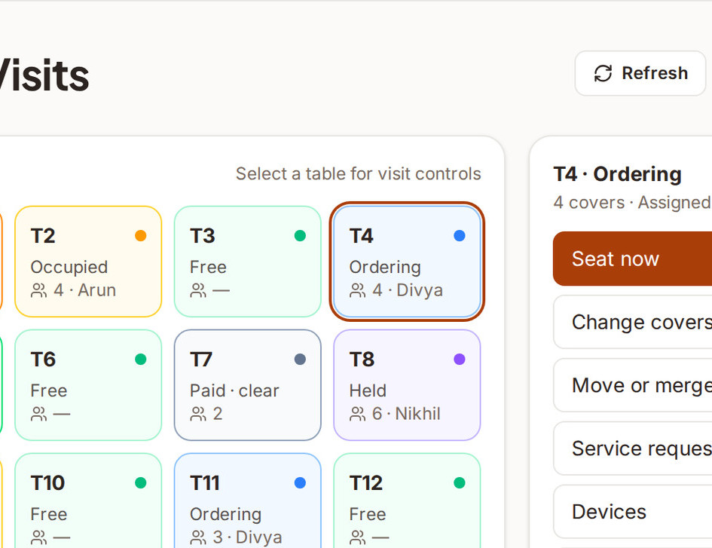
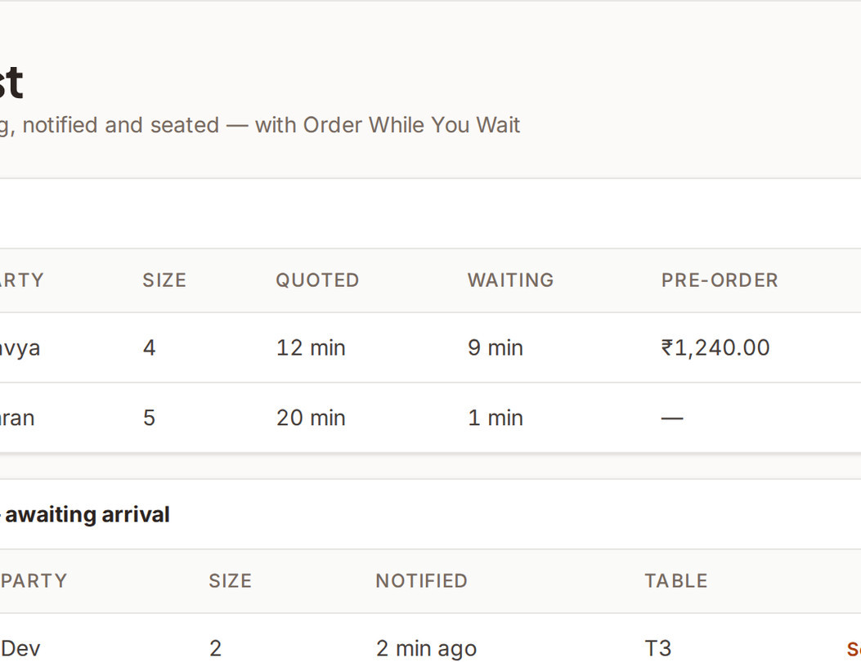
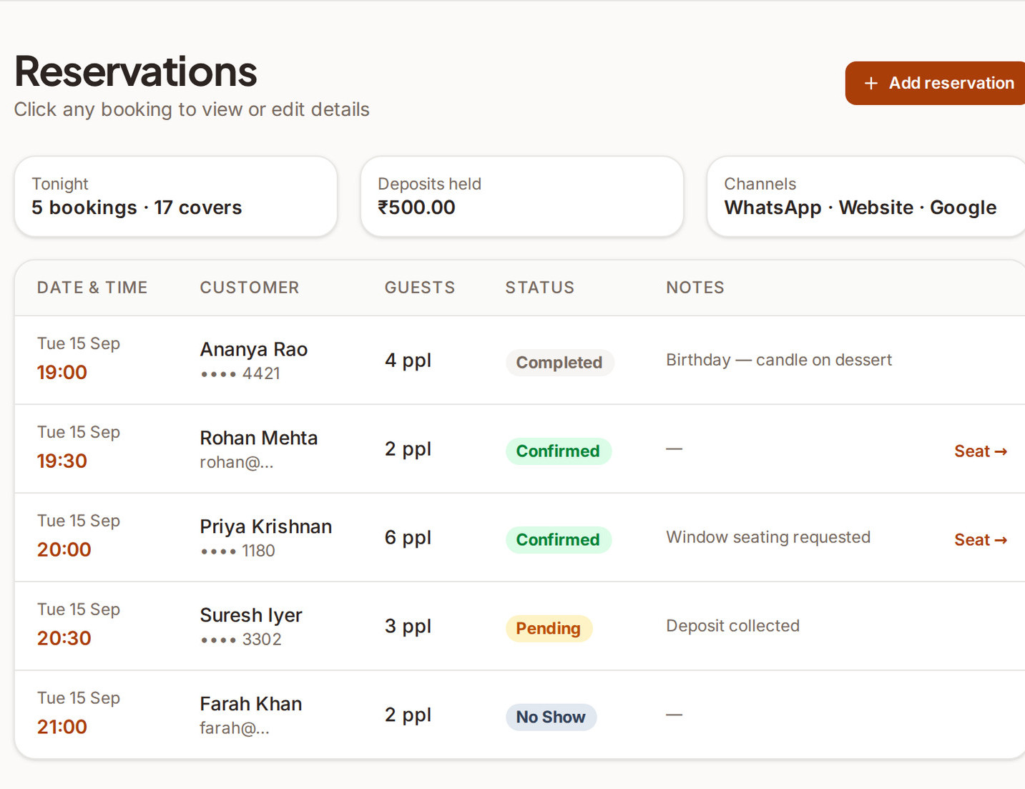
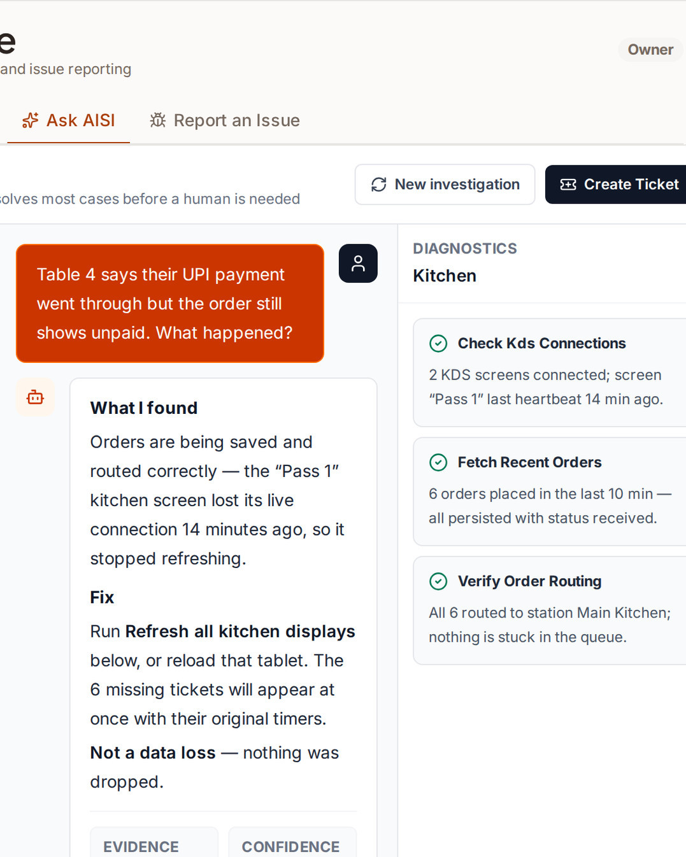
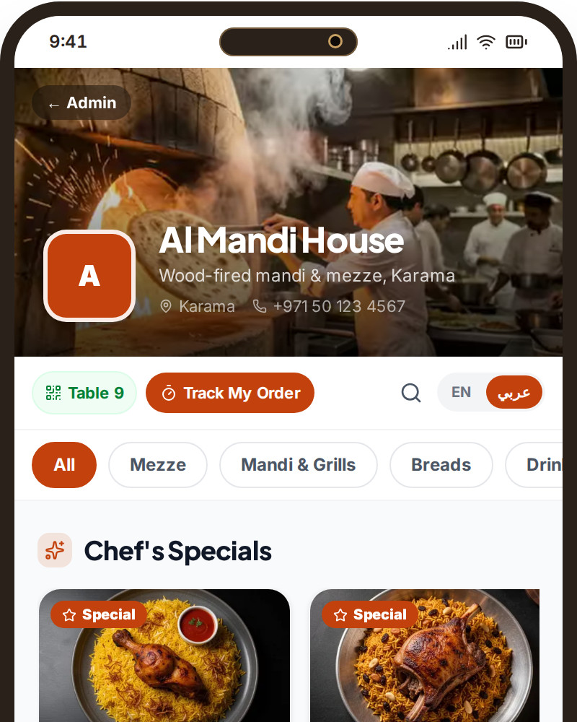
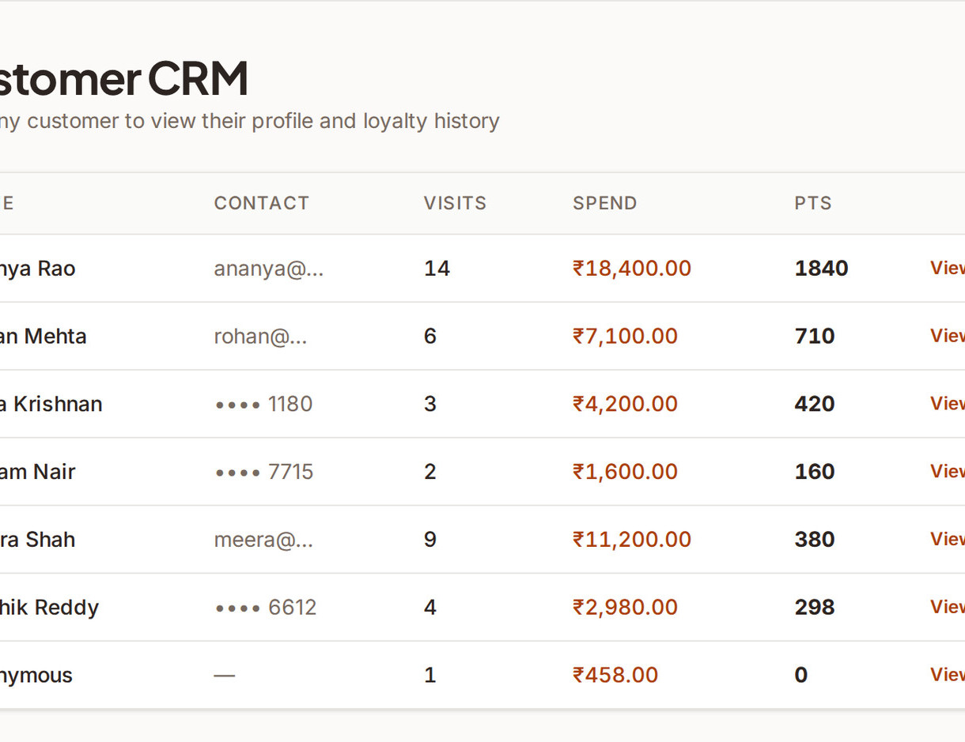
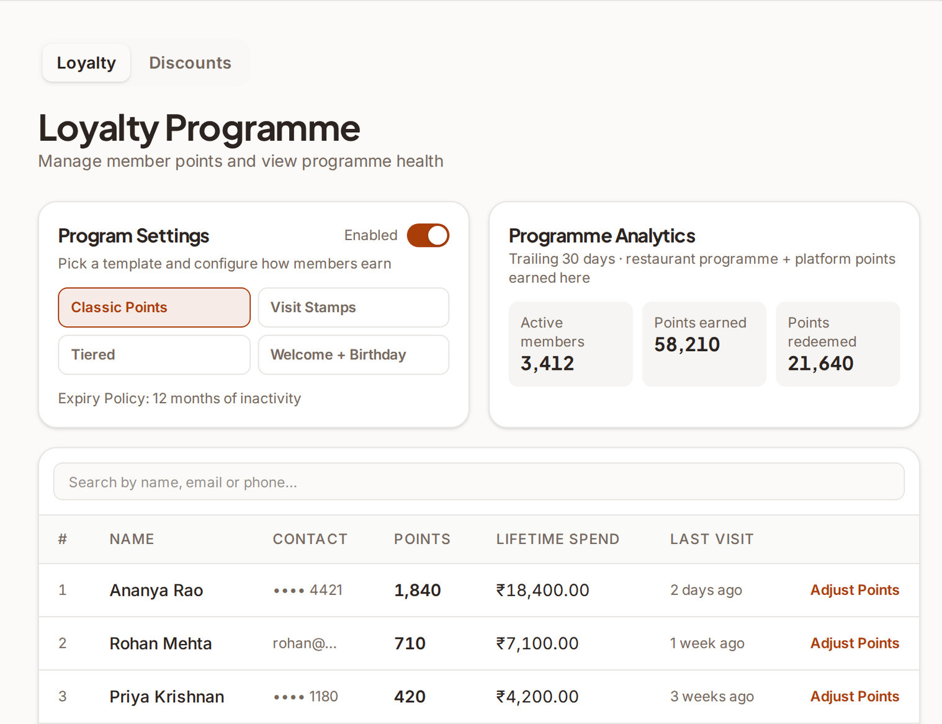
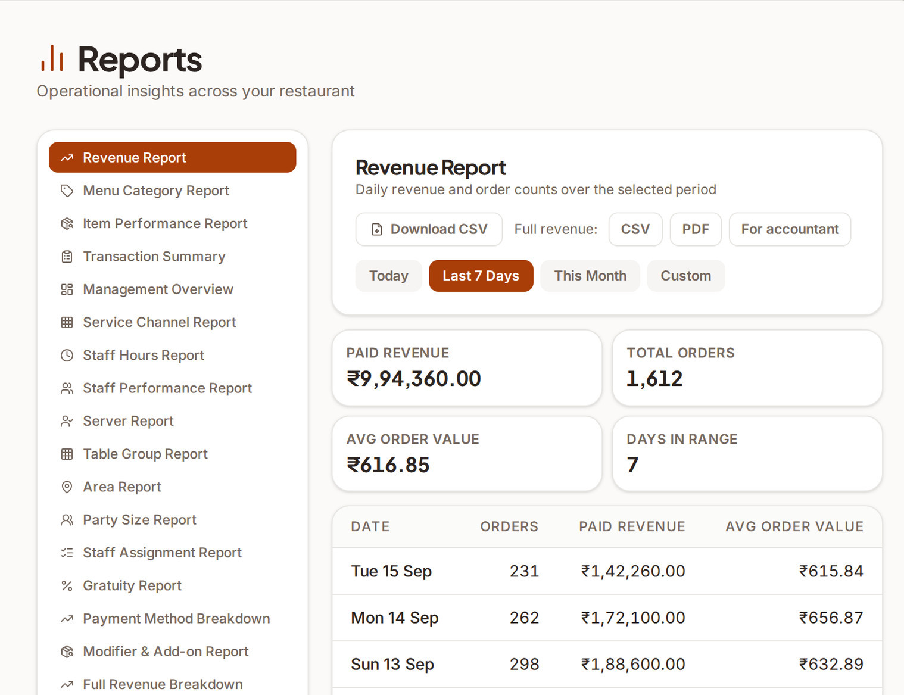
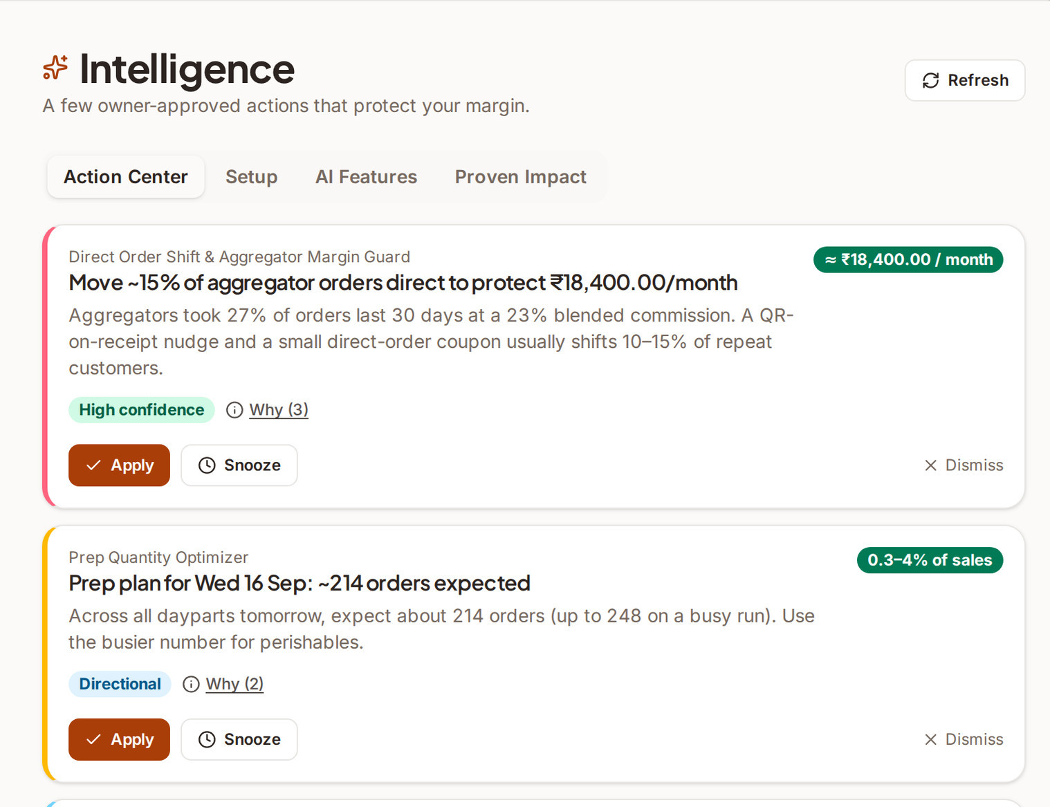
PRODUCT · BUILT, NOT PROMISED
Thirty modules, ten markets, fourteen engines — and a public demo anyone can open.
Guest QR menu
POS
Kitchen display
Floor & visits
Waitlist + pre-orders
Reservations
CRM
Loyalty
Reports (19 types)
Intelligence (14 engines)
AISI support
10 markets · 21 languages
Also live: POS terminals (Stripe Terminal, Razorpay POS, Pine Labs, Square, Tyro, Zeller, SumUp by market) · delivery aggregators (Zomato, Swiggy, Uber Eats, DoorDash, Menulog, Deliverect) · AI menu scan · POS migration assistant · tax invoices · campaigns · timeclock · 9 staff roles · master-admin control plane · OotaOS Lite (India, UPI matched from bank SMS).
OotaOS · Seed 2026 · Confidential · Live product: ootaos.com/product
6

Slide 7
BUSINESS MODEL
Usage-priced at the bottom of the market, subscription at the top — one platform, ten currencies.
LITE (India)
STARTER
GROWTH
PRO
₹0.15 / order
₹2 / order, capped ₹499 / mo
₹2,499 / mo
₹4,999 / mo
Street food & micro-eateries · no monthly fee · UPI matched from bank SMS · Android app
Growing restaurants · order lifecycle, KDS, tax invoices, reports · US $0.19 / order capped $29
Full-floor restaurants · CRM, loyalty, campaigns, waitlist, finance, intelligence, delivery · US $79 · AU A$99 · UK £69
Chains & franchises · multi-branch, tax filing · US $129 · AU A$169 · UK £109
REVENUE LAYERS ON TOP OF PLANS
WHY THIS SHAPE
Managed payments: 4.89% (India) · 5.89% + $0.30 per transaction (international)
Campaign credit packs for email/WhatsApp sends; loyalty settlement rails across restaurants
Delivery-platform connections and menu export on Growth+
Annual billing at ~21% discount; trial runs on the plan chosen, falls back to Starter per-order pricing
Per-order pricing removes the adoption barrier for the long tail — the Lite wedge into a segment no incumbent serves
Subscriptions carry the margin once a restaurant runs its floor on OotaOS; plan gates are enforced in-product
Same codebase in ten currencies: a new market is configuration and partners, not a rebuild
Pricing is live in the product and on ootaos.com/pricing (verified 26 Sep 2026). Non-India Lite billing: designed, not yet collecting.
OotaOS · Seed 2026 · Confidential · Live product: ootaos.com/product
7

Slide 8
FINANCIAL PLAN · DESIGN TARGETS, PRE-GA
Plan: 500 restaurants by month 6, 1,500 by month 12, 3,500 and a US $6.3M ARR run-rate by month 18.
$6.3M ARR
Metric | Design target | Note
Blended ARPU | $28 (M3) → $150 (M18) | Mix shifts from per-order Starter to Growth/Pro subscriptions
CAC | ~$140 | Consent-led WhatsApp outreach + field sticker motion for Lite
Payback | 3–4 months | Per-order revenue starts in month one
LTV / CAC | 12–18× | Low churn assumption for a system of record; to be validated
Gross margin | 70–75% | Payments pass-through excluded; ~$17/month infrastructure baseline pre-GA
Cash-flow positive | ~Month 8 | "Default-alive" by M9–M12 on the base case
Year-1 OpEx | ~$521K | Against $800K opening cash
$1.8M ARR
$300K ARR
M6
M12
M18
500 restaurants
1,500 restaurants
3,500 restaurants
M18 scenarios: conservative $3.8M · base $6.3M · aggressive $9.0M ARR
All unit-economics figures are design targets from the 36-month model — the company is pre-revenue and none are measured yet. We state that plainly.
OotaOS · Seed 2026 · Confidential · Live product: ootaos.com/product
8

Slide 9
GO-TO-MARKET
India first, Australia second, partners for the rest — with a wedge for every size of restaurant.
INDIA · PRIMARY MARKET
AUSTRALIA · SECOND MARKET
EIGHT MORE MARKETS · PARTNER MODEL
38,770-record proprietary restaurant prospect database (target 300K) across seven metros
Consent-led WhatsApp outreach on DLT-registered templates; opt-in is an explicit funnel stage
Lite wedge: field-sales QR-sticker motion for street food and micro-eateries — no card, no monthly fee
Migration assistant + AI menu scan as the switching wedge off Petpooja / POSist / Excel
First design partner (SAPASA Cafe) in onboarding
Founder holds dual Indian–Australian citizenship — native footing for entity, banking and relationships
Configuration live today: AUD, GST 10% / ABN invoices, Stripe, Uber Eats / DoorDash / Menulog, Tyro / Zeller / Square / SumUp terminals
Country manager hire planned at month 12 (from the round)
Unfair-contract-terms and Privacy Act obligations already reflected in terms and product
US, UK, Canada, Ireland, Singapore, UAE, Malaysia, Indonesia are configured and demonstrable today
Entry through local resellers and payment/terminal partners rather than direct sales
Each market adds configuration and partners, not engineering
Sequenced behind India and Australia proof points
The motion in one line: land with Lite or Starter at per-order pricing, prove the floor runs on OotaOS, expand to Growth — with the AI marketing & sales hire (month 1) owning the outreach engine end-to-end.
OotaOS · Seed 2026 · Confidential · Live product: ootaos.com/product
9

Slide 10
COMPETITION
Everyone sells a piece of the restaurant. OotaOS sells the operating layer.
 | India POS suites (Petpooja, POSist/Restroworks, Torqus) | Global POS platforms (Toast, Square, Lightspeed, Clover) | QR / ordering point tools | Delivery aggregators (Zomato, Swiggy, Uber Eats) | OotaOS
One data model: guest, visit, kitchen, money | Partial | Partial | No | No | Yes
Guest QR ordering + POS + KDS in one | Add-ons | Yes (own hardware) | QR only | No | Yes
Visit model (table ≠ order), waitlist pre-orders | Limited | Limited | No | No | Yes
CRM · loyalty · campaigns from the order stream | Add-ons | Add-ons | No | Own the customer | Yes
AI actions from own ledger + investigative support | No | Dashboards | No | No | Yes (14 engines, AISI)
Ten market configurations (tax, rails, languages) | India only | Western markets | Varies | Per market | Yes
Per-order pricing for micro-eateries | No | No | Some | Commission | Lite ₹0.15 / order
Owned direct channel vs commission | n/a | n/a | n/a | 20–30% commission | Direct, measured by channel
Positioning, not a feature war: incumbents are strong in their piece; OotaOS competes on the connected whole, the visit model, owned-data AI and multi-market configuration — and on price at the bottom of the market where no incumbent plays. Characterisations are OotaOS's reading of public product information; verify per vendor before external use.
OotaOS · Seed 2026 · Confidential · Live product: ootaos.com/product
10

Slide 11
DEFENSIBILITY
Seven proprietary innovations, and a data moat that compounds with every order.
1
2
3
4
Visit-level operating model
UPI confirmation from bank SMS (Lite)
Intelligence from the owned ledger
AISI investigative support
Table ≠ order: diners, devices, rounds and payments bound to one dining context — hard to retrofit into POS-first or QR-first products.
Zero-integration payment confirmation for street vendors: the phone reads the bank credit alert and matches the order; the SMS never leaves the device.
Fourteen engines read the restaurant's own numbers and propose actions with reasons and confidence — cost-disciplined, explainable, owner-approved.
Support that runs checks on the tenant before it answers, shows its working, and hands off with context — support cost engineered out of the model.
5
6
7
The compounding moat
Every order adds to the ledger the engines learn from, the customer graph the campaigns use and the loyalty wallet that travels across OotaOS restaurants. Competitors with a POS-only view cannot assemble it.
Compliance-grade money correctness
Migration engine
Multi-market tax & rails engine
Server-authoritative pricing; subtotal + tax + service + tip = total enforced at the database; payment confirmation never client-trusted.
POS fingerprints, dry-run, readiness score and undo for Petpooja / POSist / Square / Excel — attacks the switching cost that keeps restaurants on bad software.
Per-market tax profiles, invoice numbering, gateways, terminals and delivery integrations as configuration; a 12-country data-driven tax engine built and tested (packs activated per jurisdiction).
No patent filings to date; "proprietary innovations" is the accurate term. Trademark brief in preparation.
OotaOS · Seed 2026 · Confidential · Live product: ootaos.com/product
11

Slide 12
TRACTION & STATUS · STATED PLAINLY
Pre-revenue, production-deployed, diligence-ready: the build is the traction.
WHAT EXISTS TODAY
WHAT DOES NOT EXIST YET
RISKS → MITIGATIONS
Full platform in production (Railway): web admin, guest QR surface, phone admin, master-admin console, OotaOS Lite (India)
Public demo on sample data in all ten markets — everything in this deck is captured from it
Engineering baseline (Jul-2026 count, rounded): 240+ tables · 600+ endpoints · 100+ screens · 4,000+ automated tests
Independent readiness score 96–98/100 on the pilot gate; ~$17/month infrastructure baseline
Company incorporated 1 Jul 2026 (CIN U62011KA2026PTC223286); clean cap table, no notes or SAFEs
Revenue: 0 paying restaurants, 0 LOIs, 0 paid pilots
First design partner (SAPASA Cafe) in onboarding, not yet live
Measured unit economics — all figures are design targets
AISI auto-resolution is a design target (~80%), not a production metric
Non-India Lite billing collection (designed, not shipped); offline mode; two-way aggregator menu sync
Key-person risk → senior engineer hire (M2); documented codebase with 4,000+ tests
Sales execution → AI marketing & sales head (M1) owns outreach end-to-end; 38,770-record prospect base
Compliance across 10 markets → multi-jurisdiction plan in progress (DPDP, GDPR, PDPA, PDPL, PIPEDA); GA gated on close-out
Scale-out → Redis path boot-guarded; single-replica assumptions retired before high volume
Incumbent response → visit model, owned-data AI and Lite pricing are hard to copy quickly
We can afford this honesty because the build is already there to be diligenced.
OotaOS · Seed 2026 · Confidential · Live product: ootaos.com/product
12

Slide 13

TEAM
The build is the credential.
THE TEAM TODAY
Krish Chimakurthy
Founder & CEO
Bengaluru · dual Indian–Australian citizen
Founder & CEO · 1 full-time engineer · 2 interns · 3 technical advisors (individual capacity)
FUNDED BY THIS ROUND
20+ years in IT; 13 years as an international contractor across 22 countries; managed project budgets above US $5M
Career in IT delivery, software testing, project management and AI engineering — big-consulting rigour at startup speed
Designed and built the entire OotaOS platform pre-funding, alone: the live demo is the résumé
Chief Technology Officer Programme, IIM Visakhapatnam (2026); shipped SnapSiteBuild.com (AI web builder) — founder track record
Why this founder, this problem: two decades making software provably correct, applied to an industry that runs on unreconciled spreadsheets
M1 · AI Marketing & Sales Head — owns the outreach engine and GTM end-to-end
M2 · Senior Engineer — production hardening; retires key-person risk
M3 · Customer Success Lead — onboarding and design partners
M12 · Country Manager, Australia
TECHNICAL ADVISORS
Maheep Kumar Gautam — AI & Intelligent Automation leadership · TCS
Surendran M — Head of AI Engineering · Vantiva
Chandra Sekhar Arveti — Head of Platform Engineering · SRR CloudExpertsGuru
Affiliations for background only; advisory participation is personal. IIM Visakhapatnam does not own, fund or endorse OotaOS.
OotaOS · Seed 2026 · Confidential · Live product: ootaos.com/product
13

Slide 14
THE ASK
US $800K seed for 10%. Capital buys go-to-market, not a rewrite.
Round | US $800,000 seed
Equity | 10% · US $8.0M post-money (US $7.2M pre)
Instrument | Fresh allotment, s.62(1)(c) Companies Act 2013
ESOP | 9% pool created pre-money
Preference | 1× non-participating; ROFR + tag; broad-based weighted-average anti-dilution
Board | 2 founder + 1 investor directors, 1 observer
Founder vesting | 25% on closing, 75% over 36 months
USE OF FUNDS
Sales & onboarding
40% · $320K
AI marketing
25% · $200K
Engineering
25% · $200K
Ops & geo (Australia entity, partners)
10% · $80K
Krish Chimakurthy · Founder & CEO · info@ootaos.com · ootaos.com/product
MILESTONES THE ROUND BUYS
Term summary from the current seed materials; the term sheet governs. Valuation report (Rule 11UA / FEMA NDI) to be commissioned before allotment.
GA + compliance close-out · India paying restaurants (500 by M6) · Australia entry · 1,500 restaurants by M12 · cash-flow positive ~M8 · $6.3M ARR run-rate by M18 (base case)
OotaOS · Seed 2026 · Confidential · Live product: ootaos.com/product
14

